Slide 1
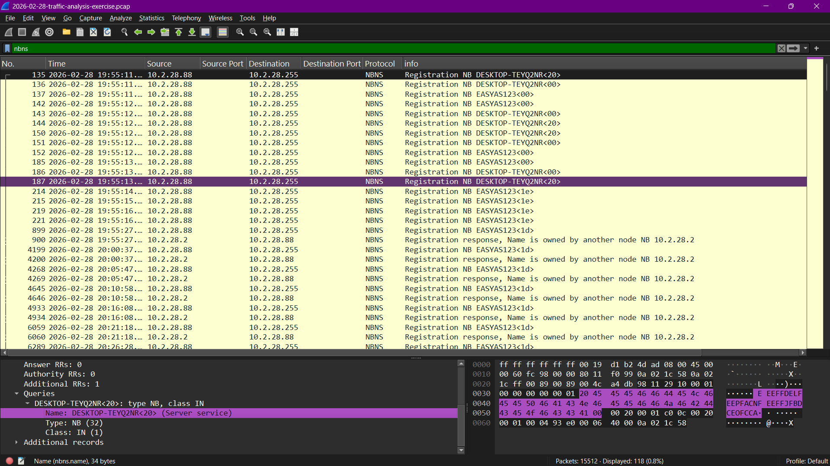
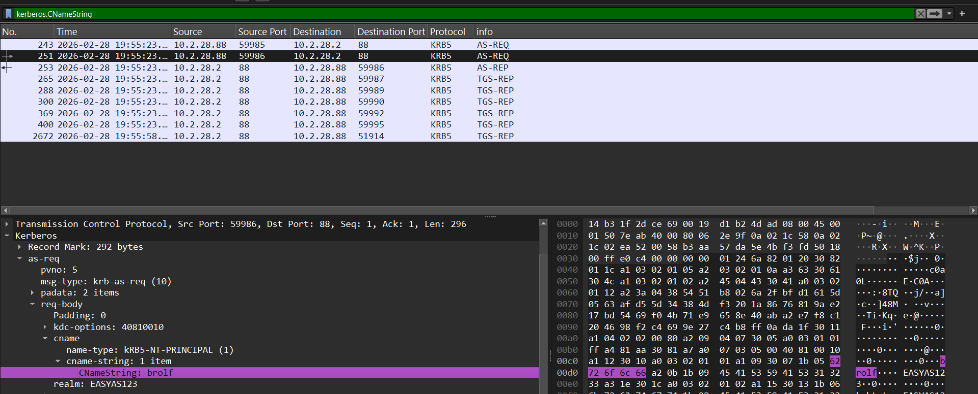
2026-02-28 - Easy as 123 Victim Identification
IP Address: 10.2.28.88
MAC Address: 00:19:d1:b2:4d:ad
Host Name: DESKTOP-TEYQ2NR
User Account: brolf
Full Name: Becka Rolf
Hostname / MAC: Type `filter nbns` to see the hostname announcements.
User: Typing `Filter kerberos.CNameString` will show the User name.

Slide 2
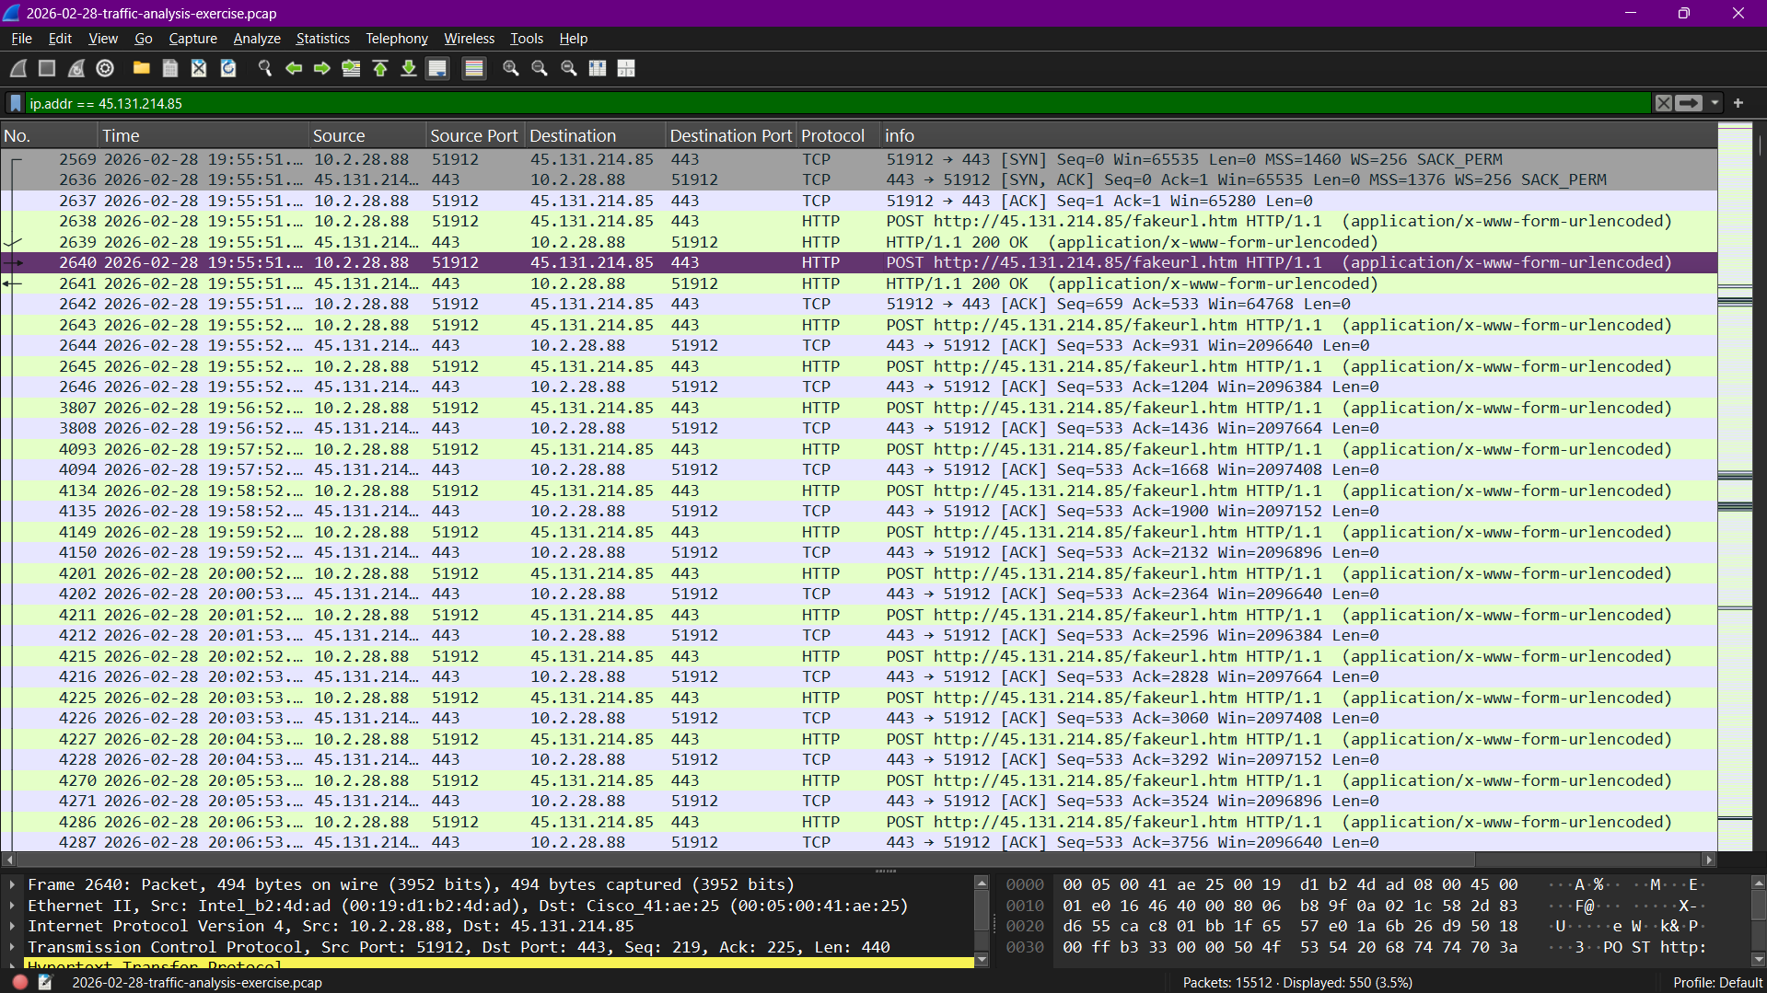
Point of Infection & C2 Traffic
Malware Type: NetSupport Manager RAT
Malicious IP: 45.131.214.85
Port: TCP 443
Type `Filter ip.addr == 45.131.214.85` to see the traffic going to the control server (C2).

Slide 3
Conclusion
-Victim Identification: The victim computer is named DESKTOP-TEYQ2NR (MAC Address: 00:19:d1:b2:4d:ad, IP Address: 10.2.28.88).
User Information: The computer belongs to an employee named Becka Rolf and is used under the user account "brolf".
Malware Behavior: An unusual connection was detected to IP address 45.131.214.85 via TCP port 443.
Conclusion & Impact: This connection behavior is consistent with the operation of the NetSupport Manager RAT malware. This malware opens a portal allowing Becka Rolf's computer to be remotely controlled by malicious actors.
Methodology: Victim identification was performed using Wireshark filters, searching through the nbns and samr protocols, and examining the kerberos.CNameString field.

